Slide 1
The diversity of plaques in London and identifying ‘bad actors’ related to the slave trade
Work experience project, Leo ellis, July 2020. Analyzing the diversity of the people commemorated on the open plaque database in London and identifying ‘bad actors’

Slide 2
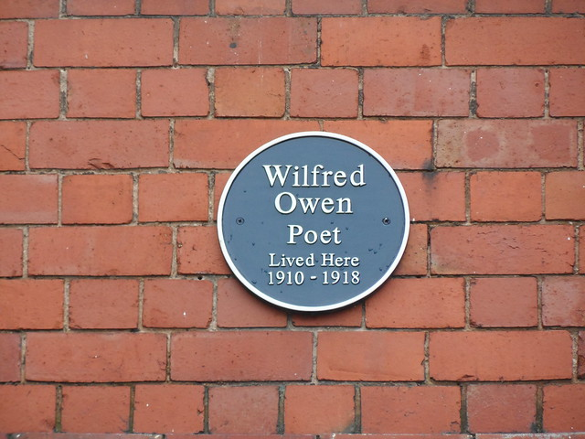
Contents
Why
Who + What
Where
When
How

Slide 3
Why
The recent interest in the ‘Black Lives Matter’ movement has led to the scrutiny of many public statues and monuments as to whether the attributed person deserves to be kept up due to their links to the slave trade and racism.
Plaques are in the public domain and thus should also undergo the same scrutiny.
It is also of interest to see the ethnic diversity of those commemorated on the plaques.
What are Open Plaques, how many, linked to a database which means can use coding and xxxx to analyse
Why did you do this – i.e coding etc
Learn about workflow
Learn about web scrapping
Real world useful outcome
Who gave you the project, what do they do
Open plaques – open source database documenting plaques
Jez
Talk about the data you had to use
s

Slide 4
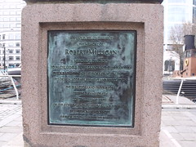
Who, what, where
This report will look at individuals commemorated by plaques found in London on the Open Plaque database.
The aim is to investigate the diversity of those commemorated on plaques in London and to identify those who have links to the slave trade.
What was the data you analysed, what did you do to analyse it
2.7k people
Describe the range of people, an dhow do they qualify to have a plaque
No specific criteria

Slide 5
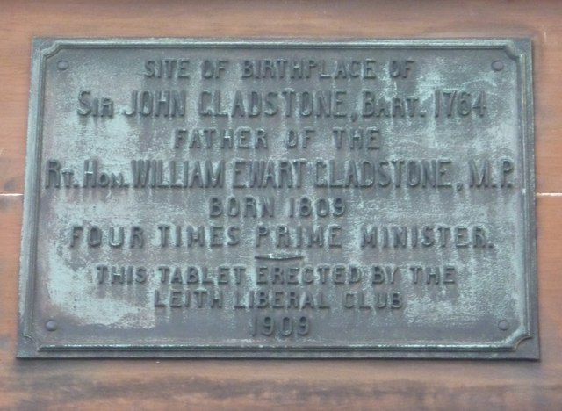
When
This report is a side project of the openplaques open source repository.link
Work on the report was done from: 11-06-2020 to 09-07-2020
Data covers

Slide 6
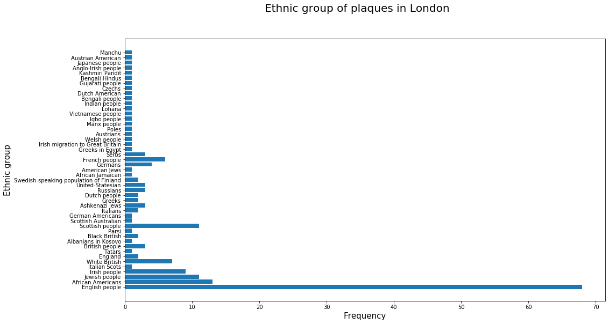
How – diversity of plaques In London
To retrieve the ethnicity of whose on the plaques, I used a qwikidata api to fetch data from the wikidata database for the individual on the plaques. Describe your process/code
~5% of the entries had ethnicity fields as a property so the chart could be bias if there are correlations to the entry being there e.g. if the entry is more likely to be there if the individual is say White British.
The chart shows the overwhelming majority of those commemorated are British/English.
Stas – total no
%

Slide 7
How – individuals with links to the slave trade
To identify bad actors I made a scoring system, using python, taking into account the following:
The presence of certain words on their Wikipedia pages list
Whether they appear on the slave owner list on Wikipedia or Wikidata
Whether they appear on the abolitionist list on Wikipedia
Ethnicity
Birth period
The above criteria gave both positive and negative scores (higher the score the worse). List scores and formula? I thought you included plantation etc, Didn’t you analyse the known slave owners to pick up key words
Words such as ‘poet’/’author’/’composer’ appearing on the Wikipedia pages reduced the score, assuming the correlation that most poets/writers/… were against slavery.
How did to test this, how did you pick the words Mention Hodge in a funny slide and problems

Slide 9
How – individuals with links to the slave trade
The results from this test finding those with the highest chance to links with slavery follow: add scores to list, why did you cut off here, total from how many?, range in scores, how did you check
Robert Milligan William Ewart Gladstone Admiral Sir Edward Codrington RN GCB FRS Simón Bolívar John Gladstone FRSE Quintin Hogg George Whitefield Richard Cobden Dr James Wilson William Murray, 1st Earl of Mansfield John Graves Simcoe Thomas Drayton Sir Lt Gen Thomas Picton GCB Sir Francis Drake John Hancock
Key:
Slave trader/owned slaves
That is not to say that the other names certainly deserve a place but they are not slave traders/owners from the Wikipedia search I conducted. Explain/reword

Slide 10
Conclusion
There is not a large diversity of nationality for those commemorated by plaques in London (n from n were not white British)
The bad actor scoring system does effectively filter down the number of possible candidates, reducing the time needed for a human to check those commemorated. From x to y
The scoring system still needs a human to validate the choices – often the links are more complicated e.g. money/slaves inherited from family which the simply model cannot differentiate.
What did you learn

